Slide 1

UMMC Occupational Therapy Department
Virtual Simulation- Module 1
What is Occupational Therapy?
4 hours
After reviewing this module, please complete the corresponding section in the
Virtual Observation Reflection packet.

Slide 2

What is Occupational Therapy?
How can occupational therapy serve you?
Watch Video:
What can occupational therapy do for you? (aota.org)

Slide 3
Occupational Therapy Practice Domain
Occupations
Client Factors
Performance Patterns
Performance Skills
Context and Environment
(American Occupational Therapy Association, [AOTA], 2014)

Slide 4
Occupations are…
Gardening
Grocery Shopping
....the activities (occupations) that people want to do, need to do, and are expected to do. (Law et al., 1990)
Enjoying a meal

Slide 5

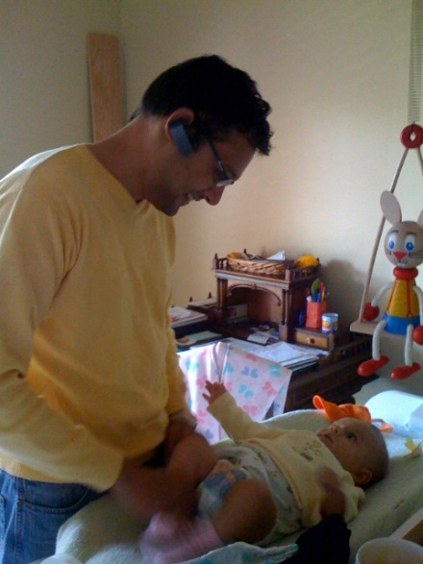



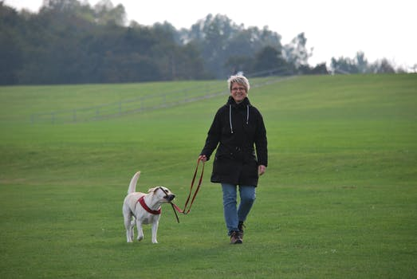
Areas of Occupation
Activities of Daily Living
Instrumental Activities of Daily Living (IADL)
Activities of daily living encompass self-care activities, such as eating, bathing, dressing, toileting, brushing teeth, shaving, etc.
“Activities to support daily life within the home and community that often require more complex interactions than those used in ADLs” [AOTA, 2014]
Ex., driving, cleaning, child and pet care, cooking, and managing money.

Slide 6

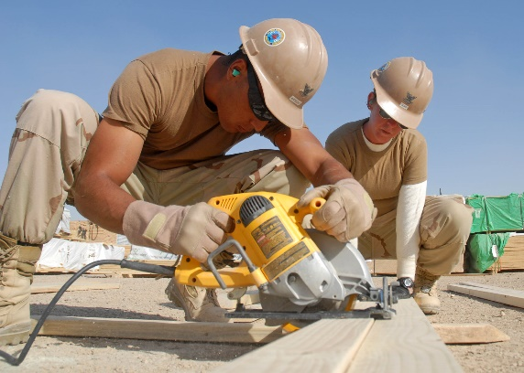

Areas of Occupation
Education
Work
“Labor or exertion; to make, construct, manufacture, form, fashion, or shape objects; to organize, plan, or evaluate services or processes” [AOTA, 2014].
This may include work you are paid for or volunteer work.
Activities needed for learning and participating in the educational environment
Ex. Reading, writing, social participation, visual and sensory processing.

Slide 7


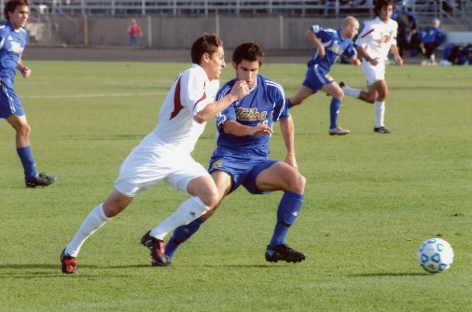

Areas of Occupation
Play
Leisure
“Any spontaneous or organized activity that provides enjoyment, entertainment, amusement, or diversion” [AOTA, 2014].
This includes games, sports, pretend play, constructive play individually or within a group.
“ Non-obligatory activity that is intrinsically motivated and engaged in during free time” [AOTA,2014}.

Slide 8


Areas of Occupation
Social Participation
Sleep and Rest
Social participation can occur in person or by telephone, text, social media and videoconferencing.
Social participation involves one other person or a group of people
“Activities including sleep preparation related to obtaining restorative rest and sleep to support healthy, active engagement in other occupations” [AOTA, 2014]

Slide 9
Reflection
1. What have you learned about occupational therapy from watching the film and reading the power points?
Does anything in the film excite you about pursuing occupational therapy as a profession?

Slide 10
References
American Occupational Therapy Association. (2014). Occupational therapy practice framework: Domain and process (3rd ed.). American Journal of Occupational Therapy, 68(Suppl. 1),S1-S48. https://doi.org/10.5014/ajot.2014.682006
American Occupational Therapy Association. (2017). What can occupational therapy do for you?[Film]. American Occupational Therapy Association. https://www.youtube.com/watch?v=jwwOXlLYQ4Q
Law, M., Baptiste, S. McColl, M. Opzoomer, A., Polatajko, H., Pollock, N. (1990). The Canadian occupational performance measure: An outcome measure for occupational therapy. Canadian Journal of Occupational Therapy, 57,82-87.
Picture References
All pictures taken from creative commons and not subject to copyright.

